Slide 1
BBA 5th Semester
Submitted by-
Sakshi (72310768)
Jaskaran Singh (72310798)
Ajay Kumar (72310762)
Manraj Singh (72310980)

Slide 2
Sectoral analytics project
HOSPITAL RESOURCE ALLOCATION (HEALTHCARE SECTOR)

Slide 3
Objective
The objective of this project is to analyze hospital resources such as beds, doctors, equipment, and medicine availability using data analytics. By leveraging Power BI, the goal is to ensure optimal allocation of resources, minimize patient wait time, and improve hospital operational efficiency.

Slide 4
Data description
The dataset contains hospital-related data, including patient admissions, staff allocation, bed occupancy, and equipment usage. The data is used to monitor, allocate, and optimize hospital resources effectively.
Key Columns Include:
Department - Cardiology, Orthopedics, General Ward, ICU, etc.
Total Beds - Number of beds available in each department.
Occupied Beds - Current bed occupancy in each department.
Doctors Available - Total number of doctors per department.
Patients Admitted - Number of patients admitted.
Equipments Used -Number of medical equipment in use.
Medicine Stock - Quantity of medicine available.
Avg Treatment-Time - Average treatment time in hours.

Slide 5
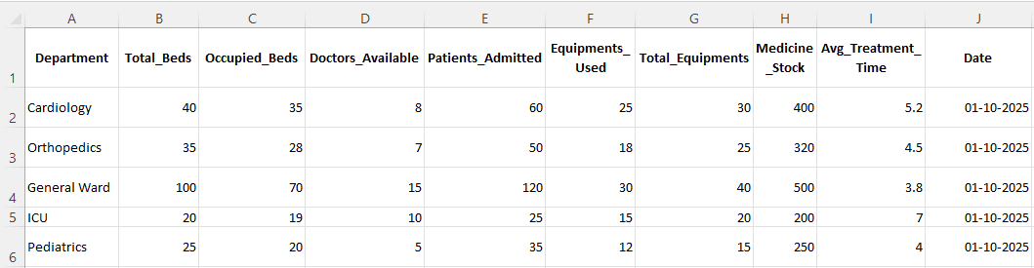

Slide 6
Dashboard description
The dashboard consists of multiple visualizations:
• Bar Chart – Average Balance by Customer Type.
• Line Chart – Total Spending by Customer Type.
• Donut Chart – Total Customers by Customer Type.
These visuals collectively provide a clear view of customer segmentation and spending patterns.

Slide 7
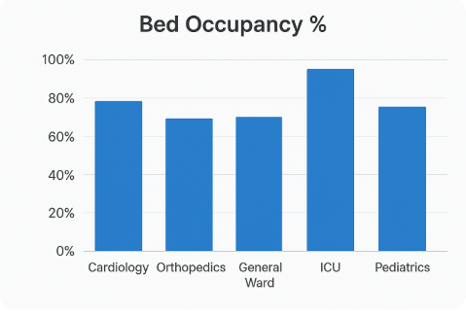
Bar chart

Slide 8
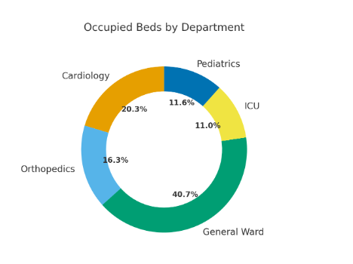
Donut chart

Slide 9
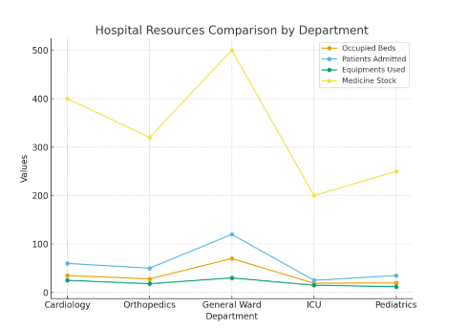
Line chart

Slide 10
Data cleaning and preparation
Before creating dashboards in Power BI, the dataset was cleaned and formatted properly. This included removing null or duplicate values, standardizing department names, and ensuring that all data types were correctly formatted for analysis.
Calculated fields were created for deeper insights:
Bed Utilization Rate = (Occupied Beds / Total Beds) * 100
Doctor-to-Patient Ratio = Patients Admitted / Doctors Available
Equipment Utilization = (Equipments Used / Total_Equipments) * 100

Slide 11
Visualizations created in power bi
A Power BI dashboard was developed to provide a complete overview of hospital resource utilization. Different charts and visuals were designed to represent the data in an interactive and insightful way.
Bar Chart – Bed Utilization Rate by Department to identify overloaded areas.
Donut Chart – Patient distribution by department.
Line Chart – Bed Occupancy Trend Over Time to identify peaks in demand.

Slide 12
Insights and analysis
ICU and Emergency Departments have utilization rates exceeding 90%, suggesting expansion needs.
General Ward shows underutilization; resources can be reallocated temporarily.
Departments with low doctor-to-patient ratios indicate staff shortages.
Average treatment time is higher in specialized units, showing room for process optimization.
Seasonal peaks in patient admissions suggest the need for dynamic resource allocation.

Slide 13
Conclusion
This project demonstrates how data analytics can revolutionize hospital management by enabling data-driven decision-making. Using Power BI, hospital administrators can easily identify over- and under-utilized departments, allocate resources efficiently, and improve overall operational performance. Predictive analytics further empowers hospitals to plan ahead and provide timely care to patients, ensuring optimal use of resources.

